Slide 1
Introduction
Introduction to Operating Systems, 2019
FIT-HCMUS
HCMUS
Operating Systems

Slide 2
Logistics
Instructor: Trần Trung Dũng
TAs:
More information (including office hours, email addresses, etc.)
  ttdung@fit.hcmus.edu.vn
If you need help outside of class hours, use email
  Start subject line with [OS]
  Emails without this tag will likely be ignored
HCMUS
Operating Systems

Slide 3
Course Overview
Goals:
  Understanding of OS and the OS/architecture interface/interaction
  Learn a little bit about distributed OS’es if having time
Prerequisites:
What to expect:
  We will cover core concepts and issues in lectures
  In sections, you and your TA will practice and talk about the project
  2 or 3 projects on Nachos
  1 Midterm and 1 Final
HCMUS
Operating Systems

Slide 4
Warning
We will take it serious if cheating!
HCMUS
Operating Systems

Slide 5
Textbook and Topics
Text: Operating System Concepts (8th Edition), Silberschatz and Galvin.
Reference book: Modern Operating Systems, Andrew S. Tanenbaum 3rd edition.
Topics
  Processes and threads
  Processor scheduling
  Synchronization
  Virtual memory
  File systems
  I/O systems
  Distributed systems
  Security
HCMUS
Operating Systems

Slide 6
Grading
Rough guideline
  1 Midterm 40%
    Midterms will be held in common at class
  1 Final 40%
  Quiz (5% )
  Lab (20%)
Remember, this is just a rough guideline
  Grading should really be based on how much you have learned from the course
    Any concrete thing that you do towards convincing me of this may help
    For example, showing up at lab hours and participating in class will likely help
HCMUS
Operating Systems

Slide 7
Today
What is an Operating System?
Major OS components
A little bit of history
Silberschatz Chapter 1 & 3 (3.1-3.4)
HCMUS
Operating Systems

Slide 8
What Is An Operating System?
application (user)
operating system
hardware
A software layer between the hardware and the application programs/users which provides a virtual machine interface: easy and safe
A resource manager that allows programs/users to share the hardware resources: fair and efficient
A set of utilities to simplify application development
HCMUS
Operating Systems

Slide 9

Abstract View of System Components
HCMUS
Operating Systems

Slide 10
Why Do We Want An OS?
Benefits for application writers
  Easier to write programs
    See high level abstractions instead of low-level hardware details
      E.g. files instead of disk blocks
  Portability
Benefits for users
  Easier to use computers
    Can you imagine trying to use a computer without the OS?
  Safety
    OS protects programs from each other
    OS protects users from each other
HCMUS
Operating Systems

Slide 11
Mechanism And Policy
application (user)
operating system: mechanism+policy
hardware
Mechanisms: data structures and operations that implement an abstraction (e.g. the buffer cache)
Policies: the procedures that guides the selection of a certain course of action from among alternatives (e.g. the replacement policy for the buffer cache)
Want to separate mechanisms and policies as much as possible
  Different policies may be needed for different operating environments
HCMUS
Operating Systems

Slide 12
Basic computer structure
CPU
Memory
memory bus
I/O bus
disk
Net interface
HCMUS
Operating Systems

Slide 13
System Abstraction: Processes
A process is a system abstraction:
illusion of being the only job in the system
user: run application
create, kill processes,
inter-process comm.
operating system: process
Multiplexing resources
hardware: computer
HCMUS
Operating Systems

Slide 14
Processes: Mechanism and Policy
Mechanism:
  Creation, destruction, suspension, context switch, signaling, IPC, etc.
Policy:
  Minor policy questions:
    Who can create/destroy/suspend processes?
    How many active processes can each user have?
  Major policy question that we will concentrate on:
    How to share system resources between multiple processes?
    Typically broken into a number of orthogonal policies for individual resource such as CPU, memory, and disk.
HCMUS
Operating Systems

Slide 15
Processor Abstraction: Threads
A thread is a processor abstraction: illusion of having 1 processor per execution context
application: execution context
create, kill, synch.
operating system: thread
context switch
hardware: processor
HCMUS
Operating Systems

Slide 16
Threads: Mechanism and Policy
Mechanism:
  Creation, destruction, suspension, context switch, signaling, synchronization, etc.
Policy:
  How to share the CPU between threads from different processes?
  How to share the CPU between threads from the same process?
  How can multiple threads synchronize with each other?
  How to control inter-thread interactions?
    Can a thread murder other threads at will?
HCMUS
Operating Systems

Slide 17
Memory Abstraction: Virtual memory
Virtual memory is a memory abstraction: illusion of large contiguous memory, often more memory than physically available
application: address space
virtual addresses
operating system: virtual memory
physical addresses
hardware: physical memory
HCMUS
Operating Systems

Slide 18
Virtual Memory: Mechanism
Mechanism:
  Virtual-to-physical memory mapping, page-fault, etc.
virtual address spaces
p1
p2
processes:
v-to-p memory mappings
physical memory:
HCMUS
Operating Systems

Slide 19
Virtual Memory: Policy
Policy:
  How to multiplex a virtual memory that is larger than the physical memory onto what is available?
  How should physical memory be allocated to competing processes?
  How to control the sharing of a piece of physical memory between multiple processes?
HCMUS
Operating Systems

Slide 20
Storage Abstraction: File System
A file system is a storage abstraction: illusion of structured storage space
application/user: copy file1 file2
naming, protection,
operations on files
operating system: files, directories
operations on disk
blocks...
hardware: disk
HCMUS
Operating Systems

Slide 21
File System
Mechanism:
  File creation, deletion, read, write, file-block-to-disk-block mapping, file buffer cache, etc.
Policy:
  Sharing vs. protection?
  Which block to allocate?
  File buffer cache management?
HCMUS
Operating Systems

Slide 22
Communication Abstraction: Messaging
Message passing is a communication abstraction: illusion of reliable (sometime ordered) transport
application: sockets
naming, messages
operating system: TCP/IP protocols
network packets
hardware: network interface
HCMUS
Operating Systems

Slide 23
Message Passing
Mechanism:
  Send, receive, buffering, retransmission, etc.
Policy:
  Congestion control and routing
  Multiplexing multiple connections onto a single NIC
HCMUS
Operating Systems

Slide 24
Character & Block Devices
The device interface gives the illusion that devices support the same API – character stream and block access
application/user: read character
from device
naming, protection,
read,write
operating system: character &
block API
hardware specific
PIO, interrupt handling, or DMA
hardware: keyboard, mouse,
etc.
HCMUS
Operating Systems

Slide 25
Devices
Mechanisms
  Open, close, read, write, ioctl, etc.
  Buffering
Policies
  Protection
  Sharing?
  Scheduling?
HCMUS
Operating Systems

Slide 26
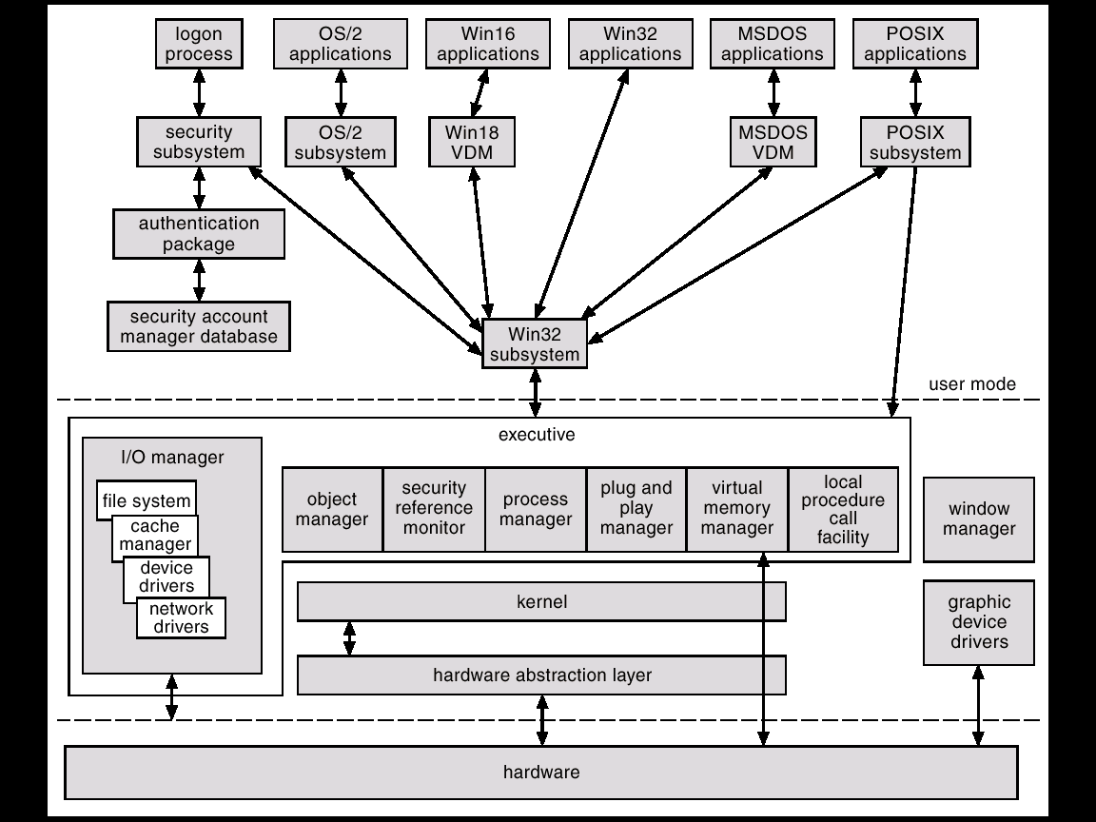
Windows 2000 Block Diagram
HCMUS
Operating Systems

Slide 27
Major Issues In OS Design
Programming API: what should the VM look like?
Resource management: how should the hardware resources be multiplexed among multiple users?
Sharing: how should resources be shared among multiple users?
Security: how to protect users from each other? How to protect programs from each other? How to project the OS from applications and users?
Communication: how can applications exchange information?
Structure: how to organize the OS?
Concurrency: how do we deal with the concurrency that’s inherent in OS’es?
HCMUS
Operating Systems

Slide 28
Major Issues In OS Design
Performance: how to make it all run fast?
Reliability: how do we keep the OS from crashing?
Persistence: how can we make data last beyond program execution?
Accounting: how do we keep track of resource usage?
Distribution: how do we make it easier to use multiple computers in conjunction?
Scaling: how do we keep the OS efficient and reliable as the imposed load and so the number of computers grow?
HCMUS
Operating Systems

Slide 29
Brief OS History
In the beginning, there really wasn’t an OS
  Program binaries were loaded using switches
  Interface included blinking lights (cool!)
Then came batch systems
  OS was implemented to automatically transfer control from one job to the next
  OS was always resident in memory
    Resident monitor
  Operator provided machine/OS with a stream of programs with delimiters
    Typically, input was a card reader back then so delimiters were known as control cards
HCMUS
Operating Systems

Slide 30
Spooling
CPUs were much faster than card readers and printers
Disks were invented – disks were much faster than card readers and printers
So, what do we do? Indirect and pipeline … what else?
  Read job 1 from cards to disk. Run job 1 while reading job 2 from cards to disk; save output of job 1 to disk. Print output of job 1 while running job 2 while reading job 3 from cards to disk. And so on …
  This is known as spooling: Simultaneous Peripheral Operation On-Line
    The use of acronyms were alive and well even back then
Can use multiple card readers and printers to keep up with CPU if needed
Improves both system throughput and response time
HCMUS
Operating Systems

Slide 31
Multiprogramming
CPUs were still idle whenever executing program needs to interact with peripheral device
  Reading more data from tape
Multiprogrammed batch systems were invented
  Load multiple programs onto disk at the same time (later into memory)
  Switch from one job to another if when the first job performs an I/O operation
    Peripheral being used had better be slower than disk (or memory)
  Overlap I/O of one job with computation of another job
  Peripherals have to be asynchronous
  Have to know when I/O operation is done: interrupt vs. polling
Increase system throughput, possibly at the expense of response time
  When is this better for response time? When is it worse for response time?
HCMUS
Operating Systems

Slide 32
Multiprogramming
P1
Run
Wait
Run
Wait
Wait
Run
Wait
Run
Wait
P2
P3
Wait
Run
Wait
Run
Wait
P1, P2, P3
Run
Run
Run
Wait
Run
Run
Run
Wait
HCMUS
Operating Systems

Slide 33
Time-Sharing
As you can imagine, batching was a big pain
  You submit a job, you twiddle your thumbs for a while, you get the output, see a bug, try to figure out what went wrong, resubmit the job, etc.
  Even running production programs was difficult in this environment
Technology got better: can now have terminals and support interactive interfaces
How to share a machine (remember machines were expensive back then) between multiple people and still maintain interactive user interface?
Time-sharing
  Connect multiple terminals to a single machine
  Multiplex machine between multiple users
  Machine has to be fast enough to give illusion that each user has his/her own machine
  Multics was the first large time-sharing system – mid-1960’s
HCMUS
Operating Systems

Slide 34
Time-sharing
P1
P2
P3
Normal Time interval
P1 Completed
I/O Started by P1
HCMUS
Operating Systems

Slide 35
Parallel OS
Some applications are comprised of tasks that can be executed simultaneously
  Weather prediction, scientific simulations, recalculation of a spreadsheet
Can speedup execution by running these tasks in parallel on many processors
Need OS and language support for dividing programs into multiple parallel activities
Need OS support for fast communication and synchronization
Many different parallel architecture
Want performance, performance, and portability
HCMUS
Operating Systems

Slide 36
Real-Time OS
Running applications have time deadlines by when they have to complete certain tasks
Hard real-time system
  Medical imaging systems, industrial control systems, etc.
  Catastrophic failure if miss a deadline
    What happens if collision avoidance software on an oil tanker does not detect another ship before the “turning or breaking” distance of the tanker?
  Challenge lies in how to meet deadlines with minimal resource waste
Soft real-time system
  Multimedia applications
  May be annoying but is not catastrophic if a few deadlines are missed
  Challenge lies in how to meet most deadlines with minimal resource waste
  Challenge also lies in how to load-shed if become overloaded
HCMUS
Operating Systems

Slide 37
Distributed OS
Clustering
  Use multiple small machines to handle large service demands
    Cheaper than using one large machine
    Better potential for reliability, incremental scalability, and absolute scalability
Wide area distributed systems
  Allow use of geographically distributed resources
    E.g., use of a local PC to access web services
    Don’t have to carry needed information with us
Need OS support for communication and sharing of distributed resources
  E.g., network file systems
Want performance (although speedup is not metric of interest here), high reliability, and use of diverse resources
HCMUS
Operating Systems

Slide 38
Embedded OS
Pervasive computing
  Right now, cell phones and PDAs
  Future, computational elements everywhere
Characteristics
  Constrained resources: slow CPU, small memories, no disk, etc.
  What’s new about this? Isn’t this just like the old computers?
    Well no, because we want to execute more powerful programs than we use to
  How can we execute more powerful programs if our hardware is similar to old hardware?
    Use many, many of them
    Augment with services running on powerful machines
OS support for power management, mobility, resource discovery, etc.
HCMUS
Operating Systems

Slide 39

Migration of OS Concepts and Features
HCMUS
Operating Systems

Slide 40
Next Time
Architectural refresher
Read Silberschatz Chapter 2
HCMUS
Operating Systems

